Slide 1
11am, 1pm and 3pm
Talks by Admissions Tutors
Laboratories open for visits: all day
Current students & staff, to talk to and do demonstrations

Slide 2
Why Physics as a degree?
A physicist has a unique range of skills that are highly employable
We teach all of our graduates
To be able to understand complex problems and how to solve them
Good practical physicists
How to work as part of a team
How to communicate in writing and speech
How to use computers in their work

Slide 3



Career prospects: earning potential
A Physicist earns an average salary of £32,517 per year. Experience strongly influences income for this job.
2014
The median salary after one year was £22,500. Higher than the estimated salaries for graduates across all degrees of £19,667
2010
According to a report by Pricewaterhouse Coopers, physics graduates earn around £188,249 more during their career than someone with A-levels but no degree. For an Arts degree this was £34,494.
2005

Slide 4

Department of Physics

Slide 5
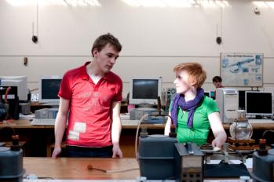
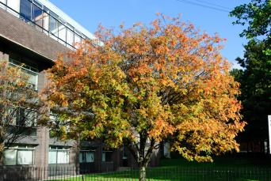
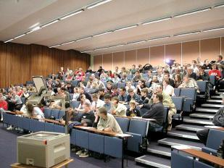
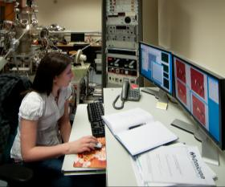
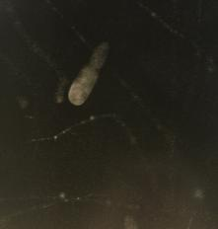
Physics at Liverpool : Supportive
We use a variety of teaching methods
Lectures
Problem classes
Tutorials
Laboratory work
Problem based learning
Private study
Excellent progression
Flexibility to transfer between courses
Open door policy
Student office
A member of staff as your contact point

Slide 6
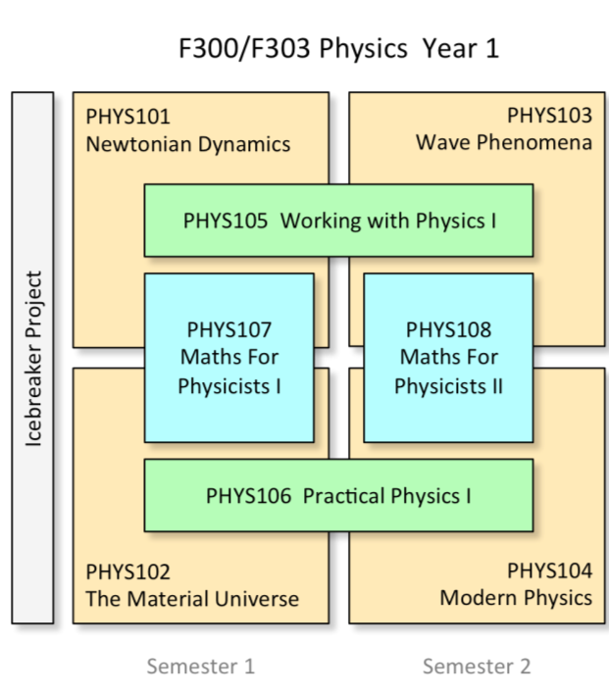
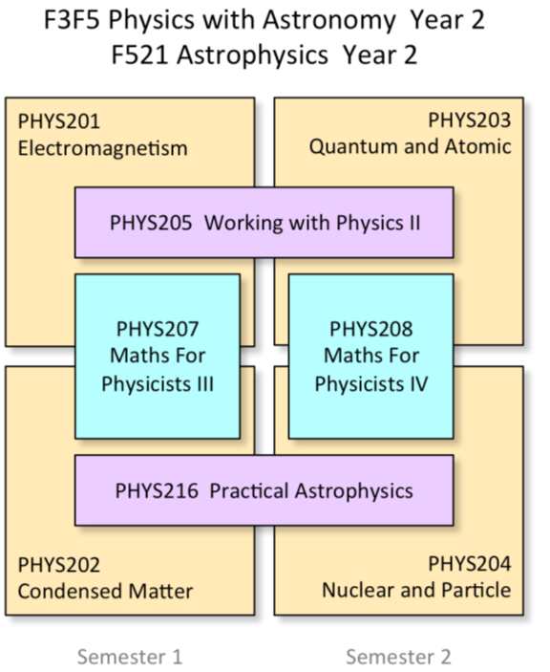
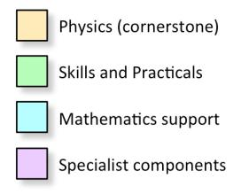

Slide 7
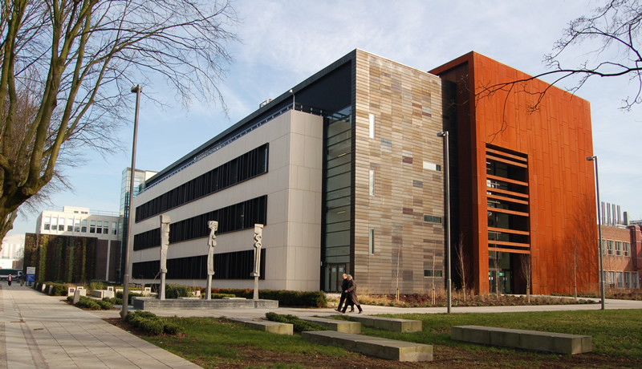

Central Teaching Laboratory
Awarded for the best University Facilities in 2013

Slide 8
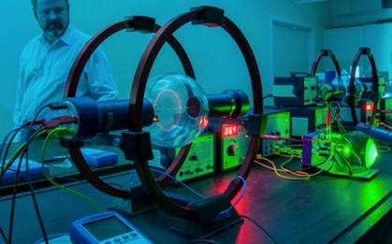
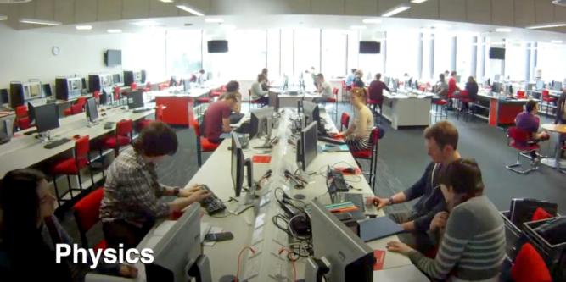
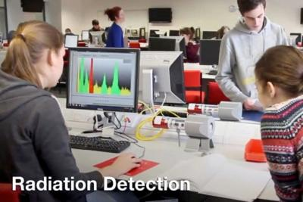
Physics laboratory equipment for undergraduates
Up to 30 sets of identical basic equipment to enable Y1 and Y2 students to work individually.
Larger equipment for final-year research-led laboratories including:
• 45 National Instruments prototyping boards
• 48 research-grade gamma-ray spectrometers
• X-ray diffractometers with CT (computed tomography) scanners
• Hand-held gamma-ray detectors
• Hand-held X-ray fluorescence analysers

Slide 9
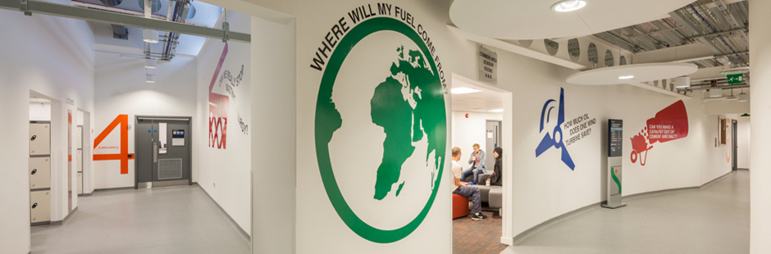
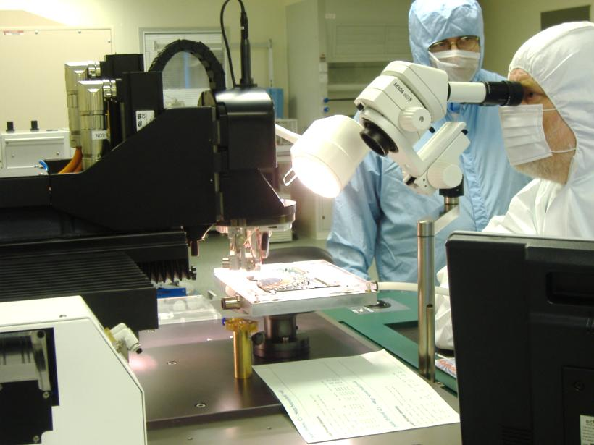
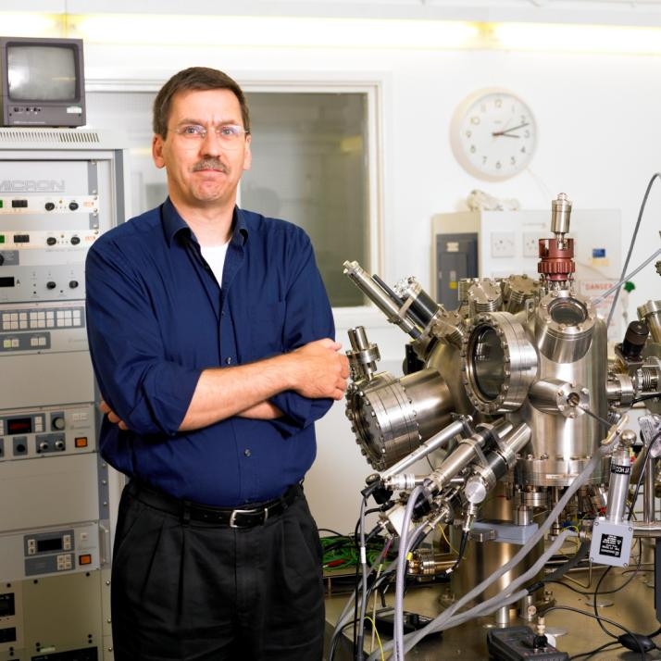
Research facilities in Liverpool
Stephenson Institute for Renewable Energy
Liverpool Semiconductor Detector Centre
Surface Science Research Centre

Slide 10
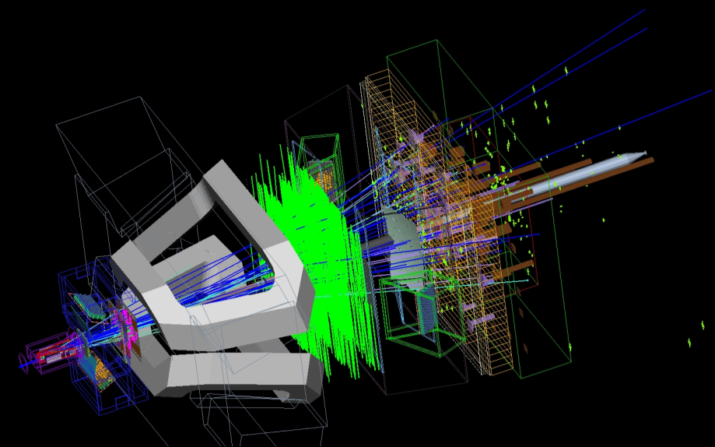
Research at Liverpool
The Physics Department is at the international forefront in the following areas:
Particle Physics

Slide 11
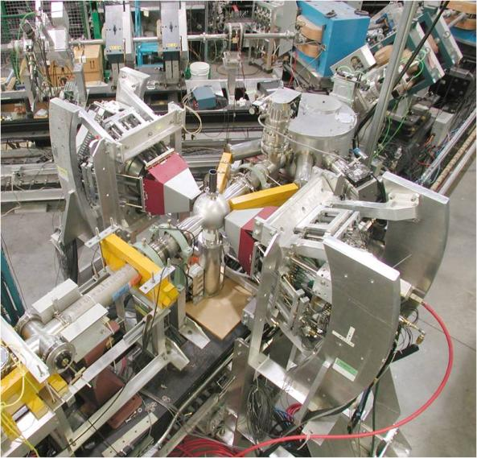
Research at Liverpool
The Physics Department is at the international forefront in the following areas:
Particle Physics
Nuclear Physics

Slide 12
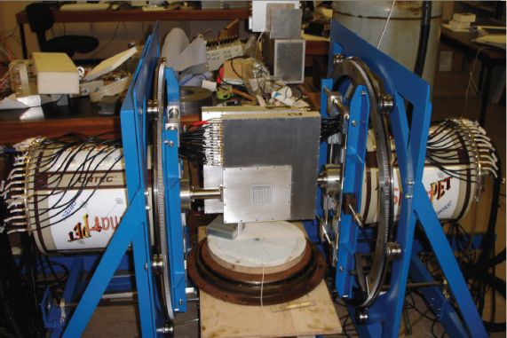
Research at Liverpool
The Physics Department is at the international forefront in the following areas:
Particle Physics
Nuclear Physics
Medical imaging

Slide 13
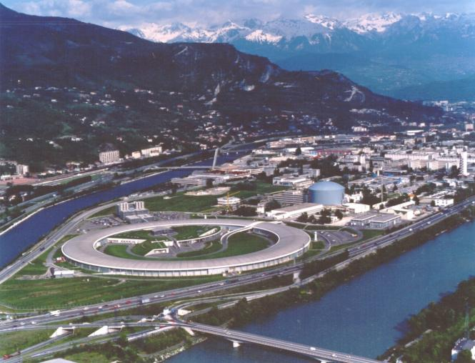
Research at Liverpool
The Physics Department is at the international forefront in the following areas:
Particle Physics
Nuclear Physics
Condensed Matter Physics

Slide 14
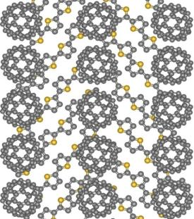
Research at Liverpool
The Physics Department is at the international forefront in the following areas:
Particle Physics
Nuclear Physics
Condensed Matter
Nanoscience
STM Image Structure
Fullerene molecules
Fullerene molecules
Use to make organic solar cells

Slide 15

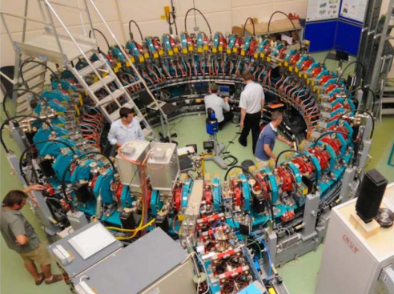

Cockcroft Institute
Based at the Cockcroft Institute, Daresbury, Cheshire
Design and build accelerators for high energy physics, material science, medical and industrial uses
Stephenson Institute for renewable energy
Research into photovoltaic power generation, energy storage and other energy problems.

Slide 16
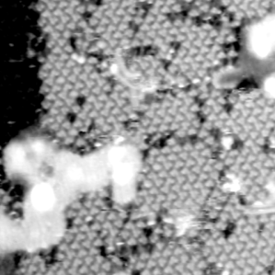
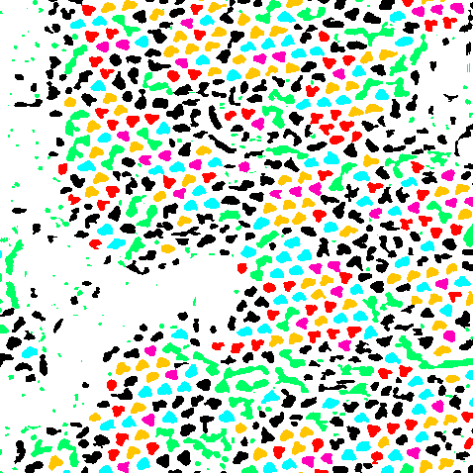
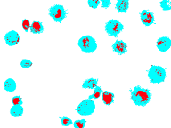
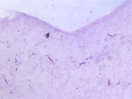
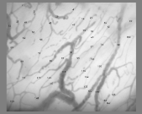
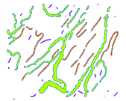
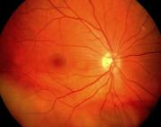
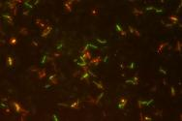
Microscopy Image Analysis
Recognising molecular shapes
Identifying molecular positions
Spin-offs in Geosciences and Medicine
Crystallographic orientation analysis (minerals)
Carbon particulate matter in lung cells (lung cancer)
Parasite analysis (malaria)
Blood flow velocities in capillary networks (meningitis)
Retinal image analysis (diabetes)

Slide 17
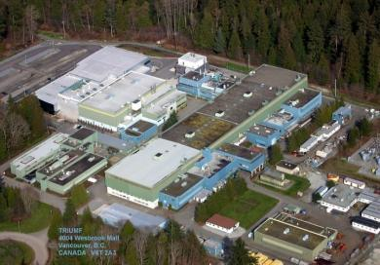
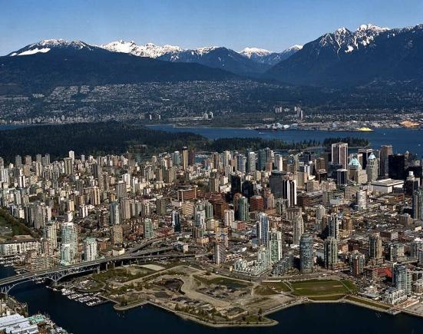
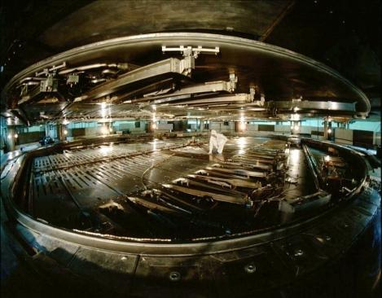
Travel opportunities : Physics
Physics MPhys
Offer some students work experience at an international laboratory
2-3 months during the summer between the third and fourth years
Paid for by the Physics department
TRIUMF in Vancouver

Slide 18
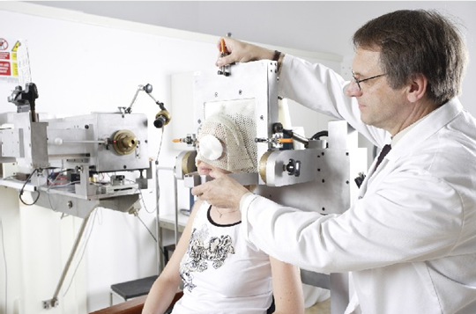
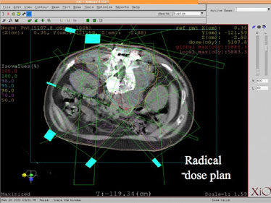
Medical physics project
The Physics with Medical applications course includes an extensive final year project with the Clatterbridge Oncology centre or Royal Liverpool Hospital

Slide 19
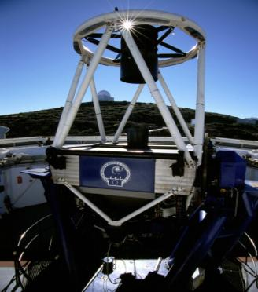
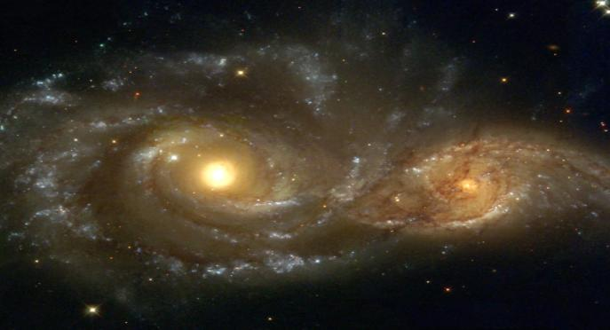
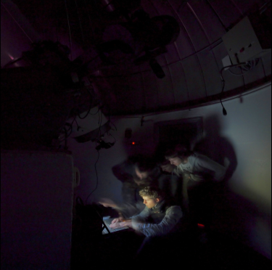
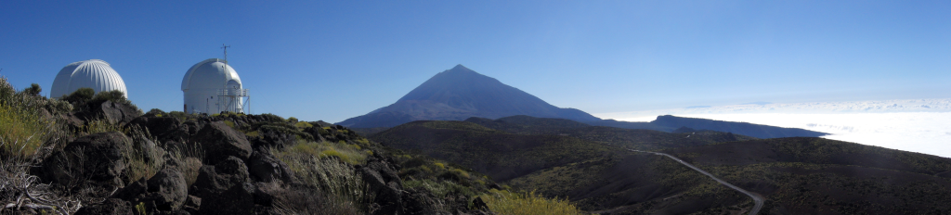
Astrophysics at Liverpool
Notes:
Note the addition of the second logo.
Since 1998 the University of Liverpool have operated a unique, collaborative, joint Astrophysics degree, combining the physics expertise here at the University of Liverpool with the Astrophysics expertise at LJMU’s ARI.
The partnership is extremely successful and essentially seamless – form day-to-day our students are based, with the rest of the physics cohort at UoL. However, they gain the benefits of membership of both Universities, an unusual example being two graduations and two degree certificates.
And we don’t just collaborate with the physics department here, our brand new planetary physics module was developed in conjunction with ****** upstairs.
We offer two degrees, F3F5 – Physics with Astronomy and F521 – Astrophysics, both of which are fully IoP accredited Physics degrees and a good proportion of the course is open (as options) to the entire physics cohort.
And we run our own national facility – the Liverpool Telescope

Slide 20
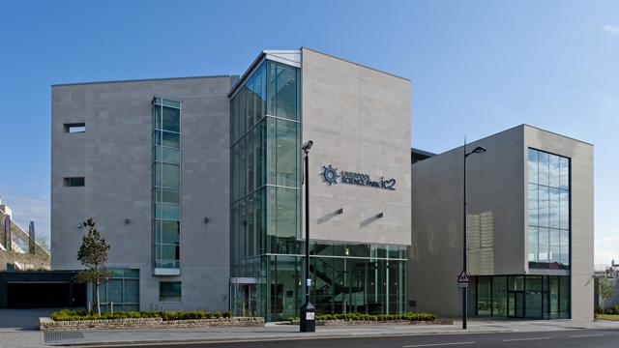
Astrophysics Research
Explosive transients: Novae, Supernovae, Gamma-Ray-Bursts
Large-scale structure / Cosmology
Active galaxies – AGN/quasars
Galaxies
Stellar populations
Stellar dynamics
Stellar evolution
Star formation
Instrumentation
Teaching
Notes:
Just as with the physics courses, the astrophysics teaching is underpinned by the world leading research carried out at the ARI – not only does our own research influence our teaching but students have the opportunity to become directly involved in the research as part of their BSc or MPhys projects.
For around the last decade large areas of astronomy have focused on changes at ever decreasing time intervals. As we will see shortly, the ARI is uniquely placed to lead in areas of “time domain astronomy”, particularly in the area of explosive transients. In this area our research is concern with the three most energetic stellar events in the Universe, novae (my own particular area), Sne and GRBs. Core collapse SN – the death of massive stars, can outshine (for a small time) their whole host galaxy. Novae, aren’t so bright, but are far more numerous. GRBs on the other hand are so energetic that, for a small fraction of time, they can outshine the entire observable Universe!
Our research spans the entire cosmic distance scale from cosmology and the large scale structure of the Universe, to active and interacting galaxies, galaxy structure and evolution, stellar populations (in galaxies and clusters), stellar dynamics, stellar evolution and star formation.
We also have a well established telescope and instrumentation group.
Our students our taught by the people involved in leading research in all of these areas. For example, the LT directory is currently co-teaching our second year astrophysics labs with me, so the person who designed and built the LT spectrograph is teaching our undergraduates spectroscopy.

Slide 21
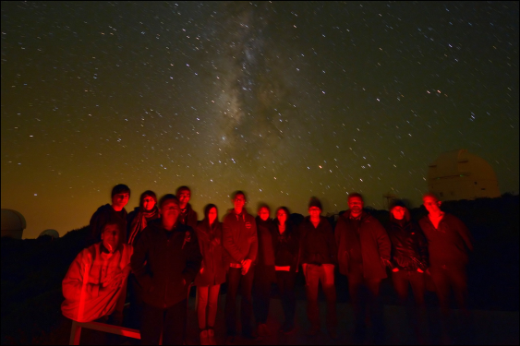
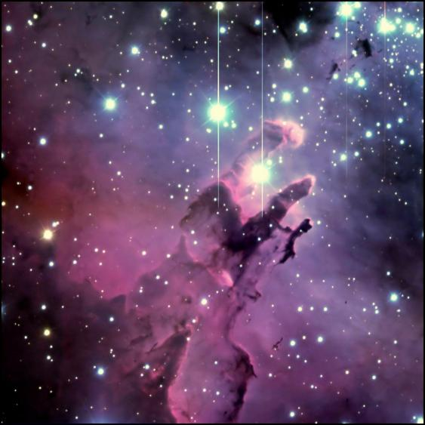
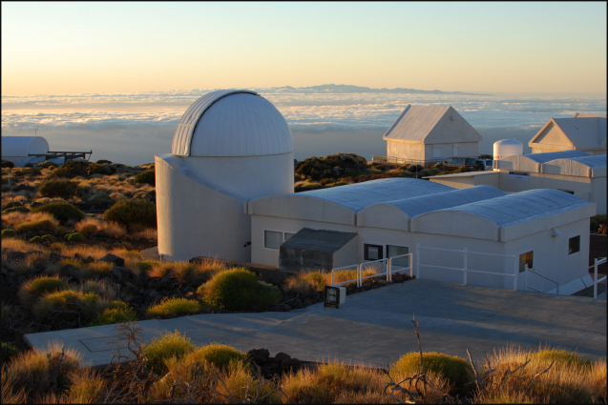
Travel Opportunities: Astrophysics
Field trip to Teide Observatory in Tenerife between 2nd & 3rd year
Notes:
Whilst Liverpool is a fantastic place to study Astrophyiscs, a large city isn’t the best place to try and do some astronomy. So to get around the British weather and the light pollution we need to travel a bit. My favorite part of the course and one which I have had the pleasure of going on for the past eight years and organizing for the past six.
Between the 2nd and 3rd years of their course, we take (should they wish to go) all our second year astro students on a *free* one week observing trip to the Teide Observatory in Tenerife. Whilst here, they have exclusive access to the 0.5M Mons telescope, last year they also had access to the 1.5M infrared Carlos Sanchez telescope and we give them a little bit of time on our own Liverpool Telescope.
They spend the entire week, planning and conducting observing programs designed by themselves using a suite of professional telescopes at one of the best observing sites in the world.

Slide 22
Study Abroad
Boston College, USA
Dalhousie University, Canada
McGill University, Canada
Monash University, Australia
University of Georgia, USA
University of Hong Kong
University of Illinois, USA
University of Newcastle, Australia
University of Ottawa, Canada
University of Toronto, Canada
University of Waterloo, Canada
Plus others…
Study Abroad is the opportunity to spend a semester overseas during your degree
All the classes you take feedback into your Liverpool degree
Doesn’t add any extra time to your degree
Still a fully registered student with us
No Tuition Fees to Host University
Liverpool Travel Award Grant: £500-£750

Slide 23
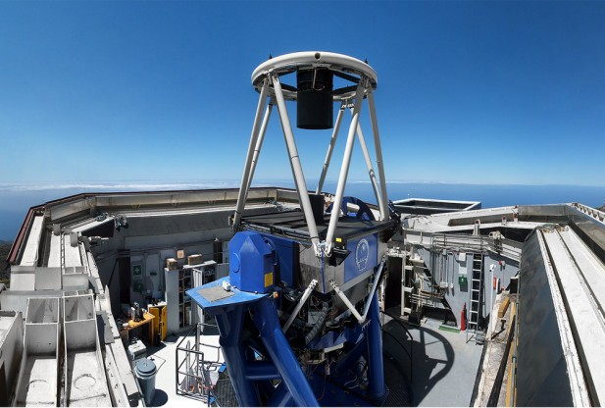
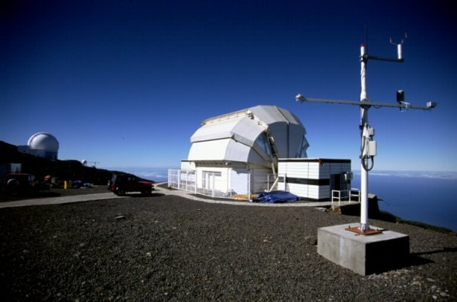

The Liverpool Telescope
World’s largest fully-robotic telescope
Notes:
A good proportion of the institute’s success in the area of time domain astronomy is due to this…
The 2.0m fully robotic Liverpool Telescope. The World’s largest fully-robotic telescope. Not the largest, largest optical telescope is over 10m in diameter – it’s technically a small telescope, but the largest robotic – and that’s the important bit.
The telescope is fully automated and computer controlled – there is nobody there – astronomers apply for time on the telescope and the entire observing programme is optimized and run by computers. This is important for two reasons, 1) it means we don’t have to be up all night, but 2) importantly, the telescope can react in real time to changes in the Universe, it can react to a discovery of a GRB or a SN. And, it can react quicker than nearly all telescopes in the world.
NSO key facility – some of you might have already used the LT
And it’s key to our teaching, our astrophysics lab data is provided by the LT, the field trip utilizes it (robotically) and a large number of our undergraduate projects are connected to the LT.

Slide 24
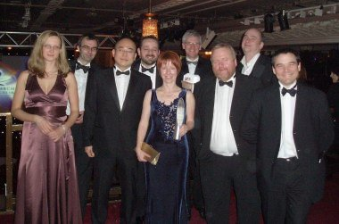

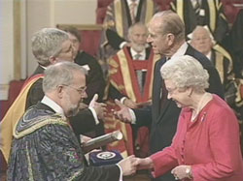
Astrophysics Research
Awarded “Research of the Year” by Times Higher Education Awards
Astrophysics in Liverpool was awarded
the Queen’s Prize for excellence and
innovation in Astronomy, including the
Liverpool Telescope Project and the
Astrophysics Degree Programme

Slide 25
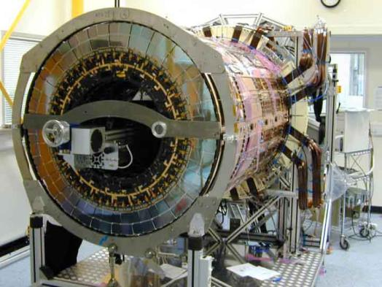
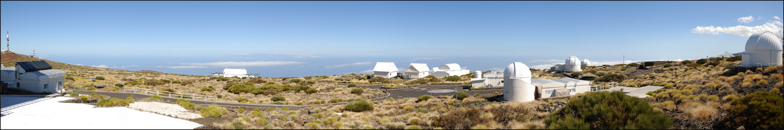
Physics at Liverpool
World-class research
Innovative, award-winning, personalised teaching
Unique access to research instrumentation
The opportunity to study physics to the highest level

Slide 26
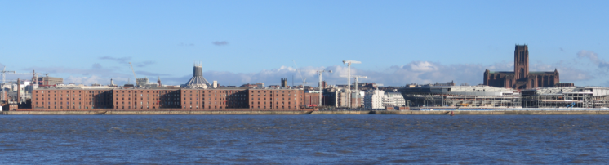

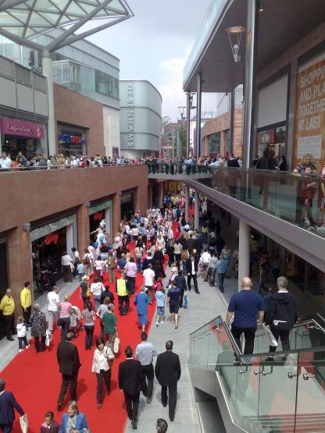

Liverpool Life
Exceptionally low cost of living.
Pleasant city to live in.
Good for cultural events.
Sport.
Shopping.
Great nightlife.

Slide 27
Please visit our labs!

Slide 29

Tuition & Tuition Fee Loan
Tuition Fee: £9,000 per year
Key message: nothing to pay before or during your course
Applies to students domiciled in UK or other member state of the EU
Tuition fees can be covered by a FEE LOAN
This loan is paid to the university directly from the Student Loan Company
The fee loan is NOT means tested

Slide 30
Maintenance Grant & Loan
Living away from home and studying outside London
Package of support for 2013/14
Household Income | Maintenance Loan | Non repayable Maintenance Grant | Total
£25,000 or less | £3,823 | £3,354 | £7,177
£30,000 | £4,292 | £2,416 | £6,708
£35,000 | £4,761 | £1,478 | £6,239
£40,000 | £5,230 | £540 | £5,770
£42,600 | £5,475 | £50 | £5,525
£42,875 | £5,500 | £0 | £5,500
£45,000 | £5,288 | £0 | £5,288
£50,000 | £4,788 | £0 | £4,788
£55,000 | £4,288 | £0 | £4,288
£60,000 | £3,788 | £0 | £3,788
Over £62,125 | £3,575 | £0 | £3,575
For more information on student finances please talk to the Student Support team in the Mountford Hall (Blgd 501)

Slide 31



Slide 32


Slide 33


Slide 34


Slide 35


Slide 36


Slide 37


Slide 38


Slide 39

End Cap constructed in Liverpool Semiconductor Detector Centre

Slide 40
Subject Review
Aspects of Provision | Grade (out of 4)
Curriculum Design, Content and Organisation | 4
Teaching, Learning and Assessment | 4
Student Progression and Achievement | 4
Student Support and Guidance | 4
Learning Resources | 4
Quality Management and Enhancement | 4
National test of teaching quality.
Panel assesses student experience.
One of the few physics departments to obtain: 24/24
One of the even fewer departments to get top rating for teaching and research. In the last National Student Survey 98% of the students were satisfied or very satisfied with their course.

Slide 41

Structure of the universe & Dark matter
December 2011 – Nobel Laureate, Professor Martin Perl accepted a Visiting Professorship at the University
Professor Perl won the 1995 Nobel Prize for Physics for the discovery of the tau lepton particle, an elementary particle similar to the electron.
Working in the department on an atomic interferometer to study small scale fluctuations in the structure of the universe and search for dark matter

Slide 42


Nuclear Physics Research
Scattered Coincidence
Random Coincidence
True Coincidence

Slide 43


Astrophysics Research
Type Ia Supernova Earliest spectrum ever taken

Slide 44

Astrophysics in Liverpool was awarded
the Queen’s Prize for excellence and
innovation in Astronomy, including the
Liverpool Telescope Project and the
Astrophysics Degree Programme

Slide 45


We founded the Stephenson institute for renewable energy last year between Physics and Chemistry: taking over Chadwick Laboratory
A CdS/CdTe solar cell

